Slide 1
Sampling and CLT
Part 3.1 Populations, Samples, Sample Mean,
Central Limit Theorem, Normal Distribution

Slide 2
But how do we learn about the population?
Q. What can we say about the heights of all US residents?
Sampling
Population
Sample
Guess about population
(e.g., summary statistics)
Inference
Info about sample
(e.g., summary statistics)

Slide 3
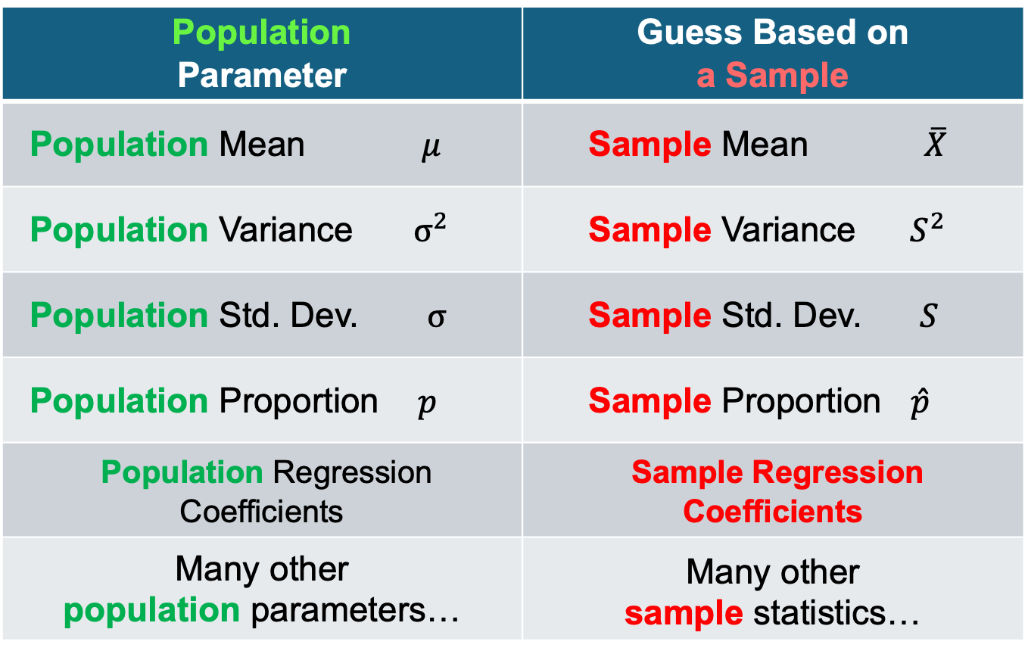
Sampling
Q. What can we say about the population from a sample?
Population Parameter | Guess Based on a Sample
Population Mean $μ$ | Sample Mean $\overline{X}$
Population Variance ${ σ}^{2}$ | Sample Variance${ S}^{2}$
Population Std. Dev. $σ$ | Sample Std. Dev. $S$
Population Proportion $p$ | Sample Proportion $\hat{p}$
Population Regression Coefficients | Sample Regression Coefficients
Many other population parameters… | Many other sample statistics…

Slide 4
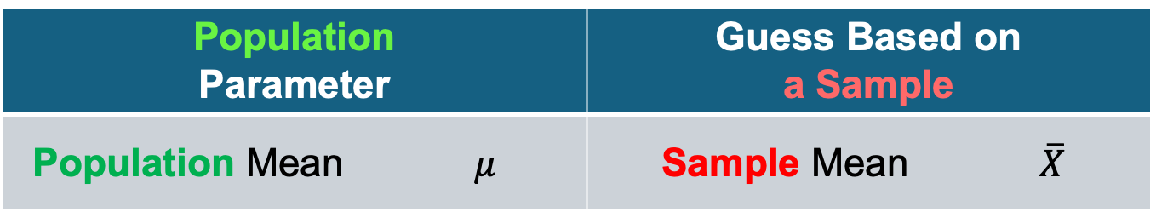
Sampling
Q. Is the sample mean a good guess for the population mean?
Population Parameter | Guess Based on a Sample
Population Mean $μ$ | Sample Mean $\overline{X}$

Slide 5
Sampling
Q. Is the sample mean a good guess for the population mean?
Yes, but we need some theory….
Population Parameter | Guess Based on a Sample
Population Mean $μ$ | Sample Mean $\overline{X}$

Slide 6
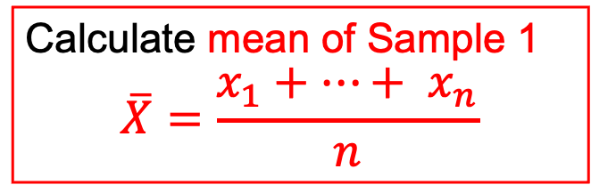
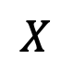
Sampling
How to guess the population mean: $μ_{X}$
Population
Sample 1
$$X$$
Calculate mean of Sample 1
$$\overline{X}=\frac{x_{1}+…+ x_{n}}{n}$$

Slide 7
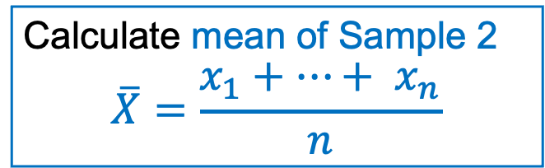
Sampling
How to guess the population mean: $μ_{X}$
Population
Sample 2
$$X$$
Calculate mean of Sample 2
$$\overline{X}=\frac{x_{1}+…+ x_{n}}{n}$$

Slide 8
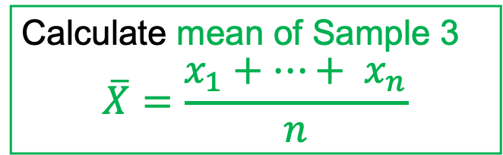
Sampling
How to guess the population mean: $μ_{X}$
Population
Sample 3
$$X$$
Calculate mean of Sample 3
$$\overline{X}=\frac{x_{1}+…+ x_{n}}{n}$$

Slide 9
Sampling
How to guess the population mean: $μ_{X}$
Population
sample mean
sample mean
$$X$$
sample mean

Slide 10

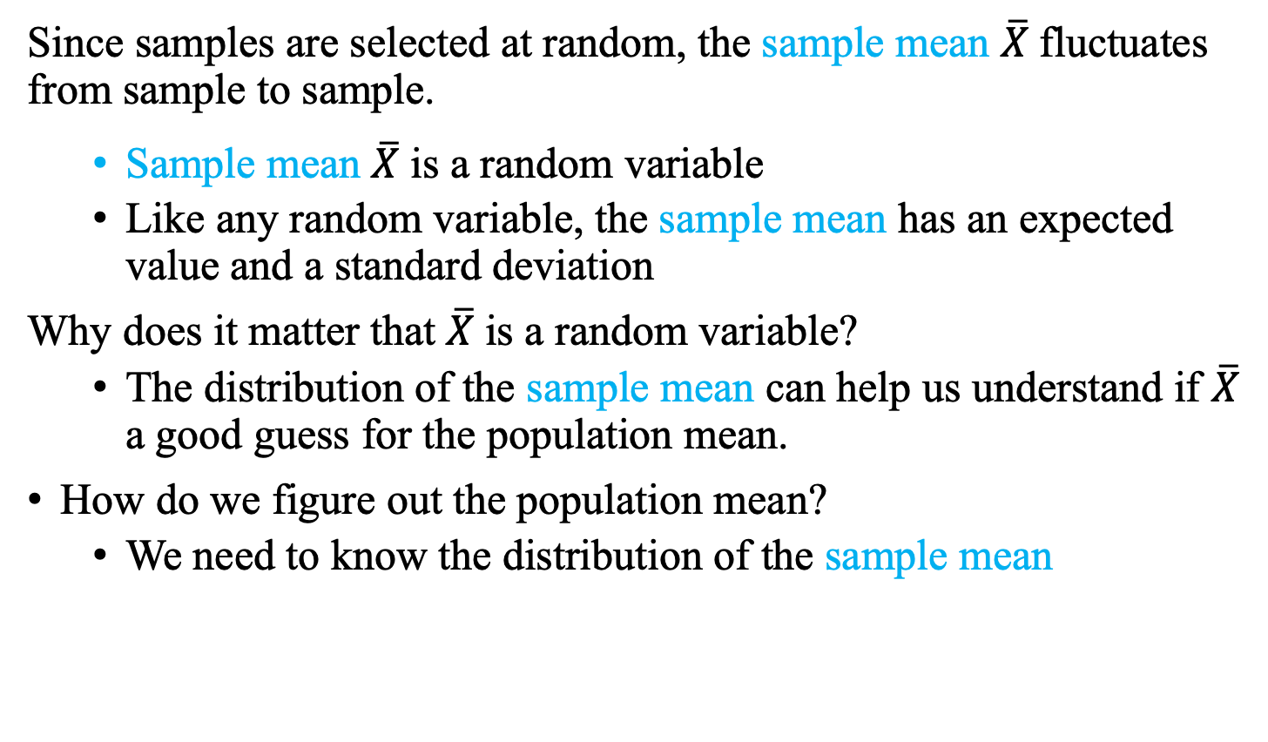
Sampling: Fluctuations in $\overline{X}$
How to guess the population mean: $μ_{X}$
Since samples are selected at random, the sample mean $\overline{X}$fluctuates from sample to sample.
Sample mean $\overline{X}$is a random variable
Like any random variable, the sample mean has an expected value and a standard deviation
Why does it matter that $\overline{X}$is a random variable?
The distribution of the sample mean can help us understand if $\overline{X}$ a good guess for the population mean.
How do we figure out the population mean?
We need to know the distribution of the sample mean

Slide 11
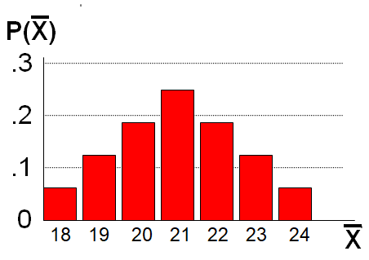
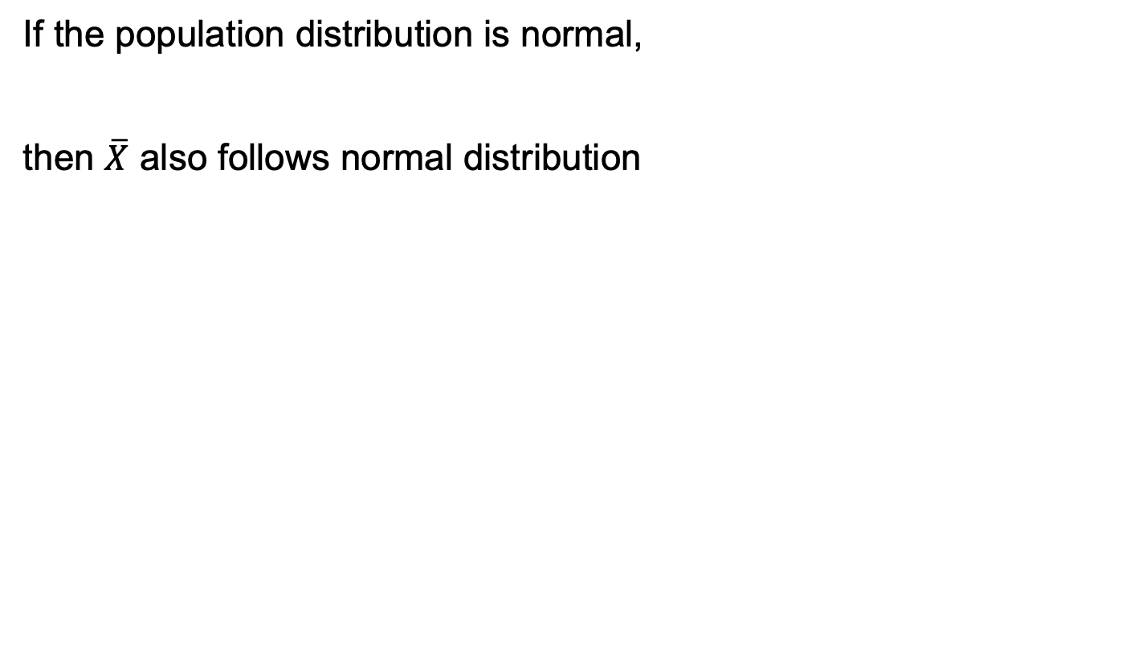
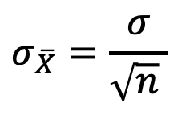
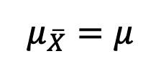
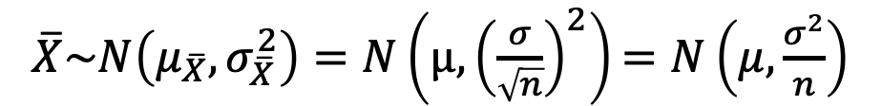
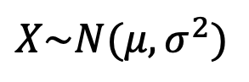

Sampling: D$istribution of \overline{X}$
What is the distribution of $\overline{X} \text{if} X is normally distributed?$
If the population distribution is normal,
then $\overline{X}$ also follows normal distribution
$$X\sim N(μ,σ^{2})$$
$$μ_{\overline{X}}=μ$$
$\overline{X}\sim N\left(μ_{\overline{X}},σ_{\overline{X}}^{2}\right)=N\left(μ, {\left(\frac{σ}{\sqrt{n}}\right)}^{2}\right)$ $=N\left(μ, \frac{σ^{2}}{n}\right)$
$$σ_{\overline{X}}=\frac{σ}{\sqrt{n} }$$
Notes:
A measure of the variability in the mean from sample to sample is given by

Slide 12
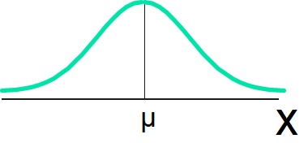
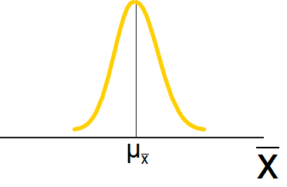
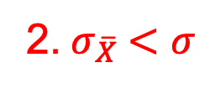
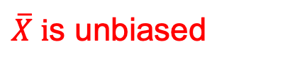
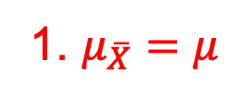
Sampling: D$istribution of \overline{X}$
What is the distribution of $\overline{X} \text{if} X is normally distributed?$
Normal
Population Distribution
1. $μ_{\overline{X}}=μ$
$\overline{X} i$s unbiased
2.${ σ}_{\overline{X}} <σ$
less spread out than X
Normal
Sample Mean Distribution
Notes:
A measure of the variability in the mean from sample to sample is given by

Slide 13
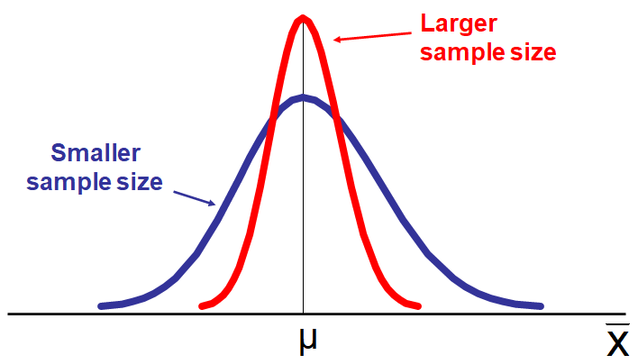
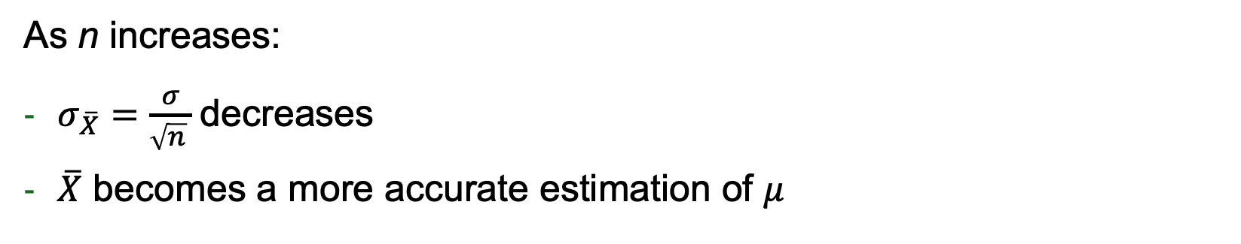
Sampling: D$istribution of \overline{X}$
What is the distribution of $\overline{X} \text{if} X is normally distributed?$
As n increases:
$σ_{\overline{X}}=\frac{σ}{\sqrt{n} }$decreases
$\overline{X}$ becomes a more accurate estimation of $μ$
Notes:
A measure of the variability in the mean from sample to sample is given by

Slide 14
Sampling: D$istribution of \overline{X}$
Q. What $\text{if} X is not normally distributed?$
The Central Limit Theorem tells us that the sample means is approximately normal if the sample size is large enough.
How large is large enough?
For most population distributions, n > 30
If population distribution is fairly symmetric, n > 5
If population distribution is normal, any n would work
Notes:
A measure of the variability in the mean from sample to sample is given by

Slide 15

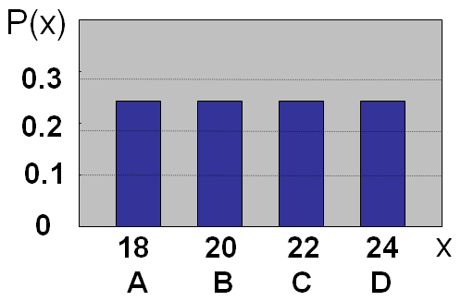
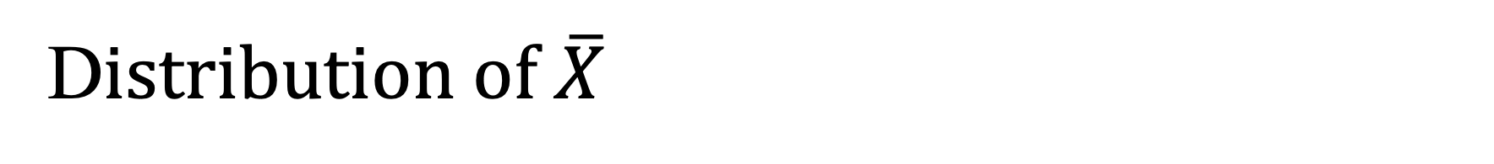
D$istribution of \overline{X}$
Assume there is a population:
Population size: N = 4
Random variable: X = age
X = 18, 20, 22, 24

Slide 16
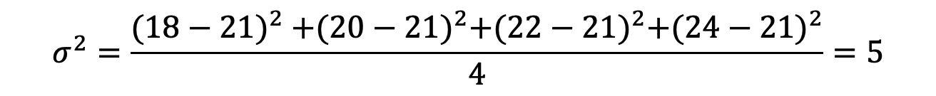
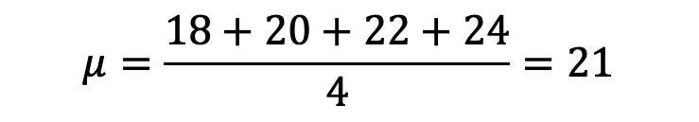
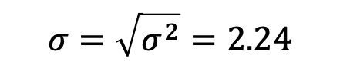
D$istribution of \overline{X}$
Summary measures of X:
Mean:
Standard deviation:
$$μ=\frac{18+20+22+24}{4}=21$$
$$σ^{2}=\frac{{(18−21)}^{2} +{(20−21)}^{2}+{(22−21)}^{2}+{(24−21)}^{2}}{4}=5$$
$$σ=\sqrt{σ^{2}}=2.24$$
Notes:
Write on the board:
Population X: {18, 20, 22, 24}
Mu = 21
Sigma = 2.24

Slide 17
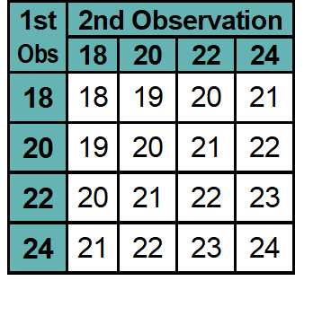
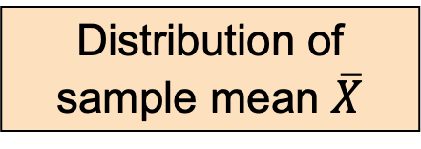
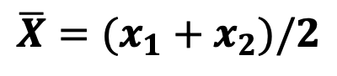
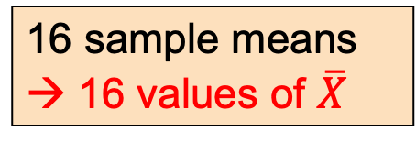
D$istribution of \overline{X}$
Consider all possible samples of size n = 2.
$${\overline{X}=(x}_{1}+x_{2})/2$$
16 sample means → 16 values of $\overline{X}$
Distribution of sample mean $\overline{X}$

Slide 18
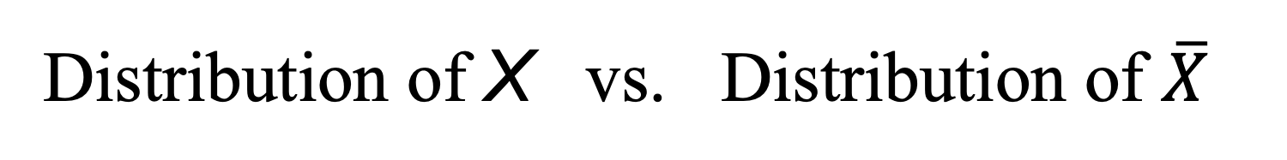
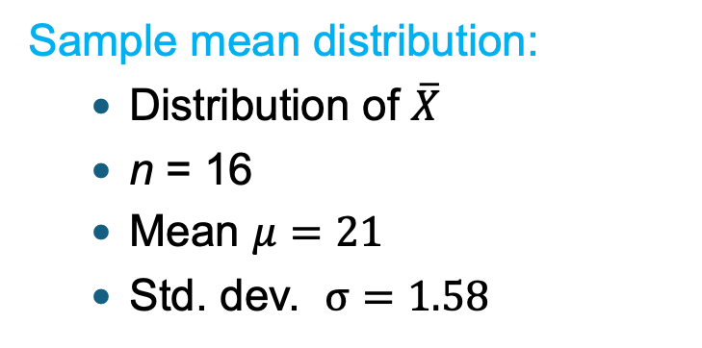
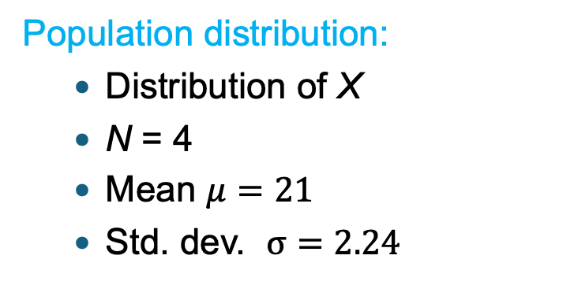
Distribution of X vs. Distribution of $\overline{X}$
Population distribution:
Distribution of X
N = 4
Mean $μ=21$
Std. dev. $σ=2.24$
Sample mean distribution:
Distribution of $\overline{X}$
n = 16
Mean $μ=21$
Std. dev. $σ=1.58$
=
>

Slide 19
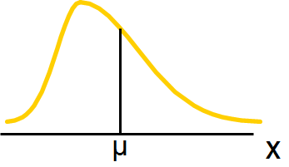
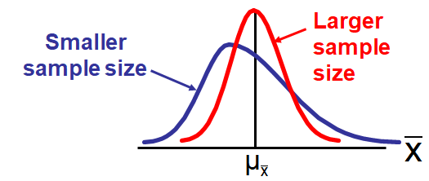
D$istribution of \overline{X}$
Q. What $\text{if} X is not normally distributed?$
Population Distribution
Sample Mean Distribution
(becomes normal
as n goes up)
Notes:
A measure of the variability in the mean from sample to sample is given by

Slide 20

Normal D$istribution$
… the single most important distribution in Statistics.
I’s also called “Gaussian” or “bell curve”.

Slide 21
Normal D$istribution$
Main motivation:
The average of a large sample of measurements drawn from a population is normally distributed (Central Limit Theorem)
Examples:
Number/size of objects produced by machines
Errors in measurements
Mathematical models that use normally distributed random variables:
Regression models
Some theories in financial economics

Slide 22
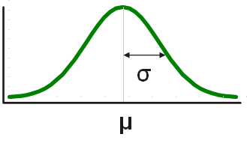
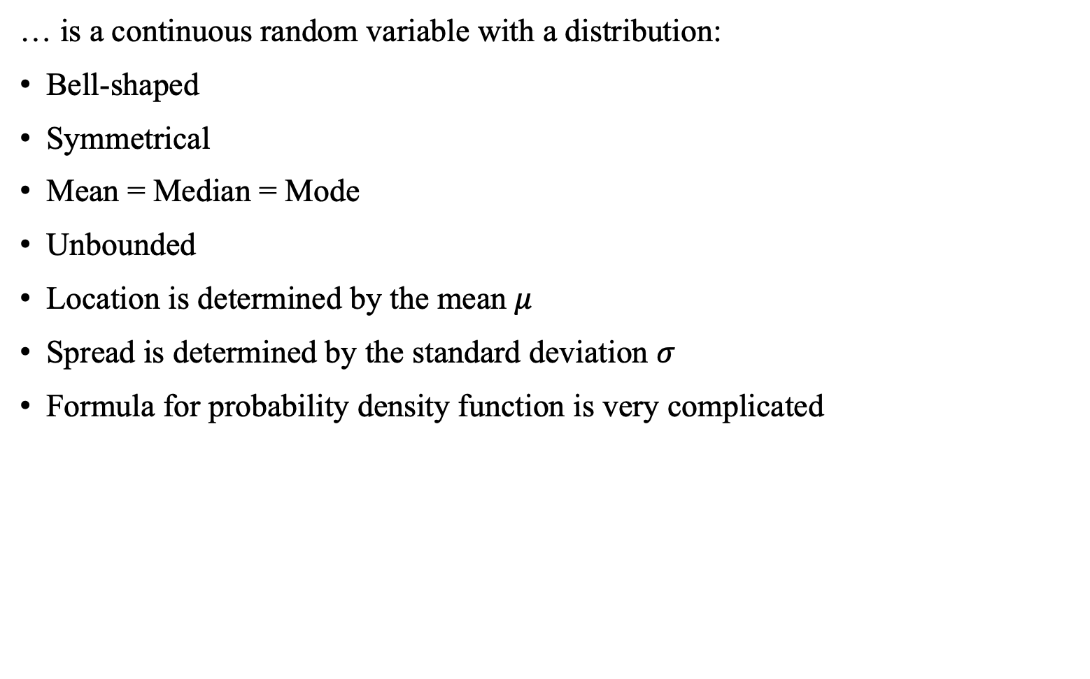

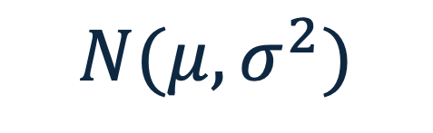
Normal D$istribution:$
$$N(μ,σ^{2})$$
… is a continuous random variable with a distribution:
Bell-shaped
Symmetrical
Mean = Median = Mode
Unbounded
Location is determined by the mean $μ$
Spread is determined by the standard deviation $σ$
Formula for probability density function is very complicated

Slide 23
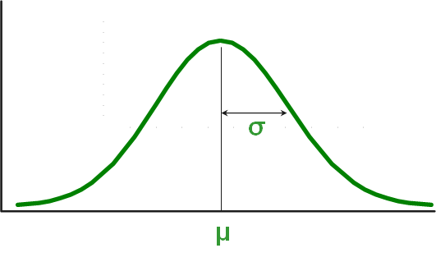

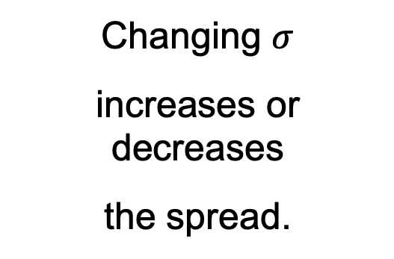
Normal D$istribution N\left(μ,σ^{2}\right):Shape$
Changing $σ$
increases or decreases
the spread.
Changing $μ$ shifts the distribution left or right.

Slide 24
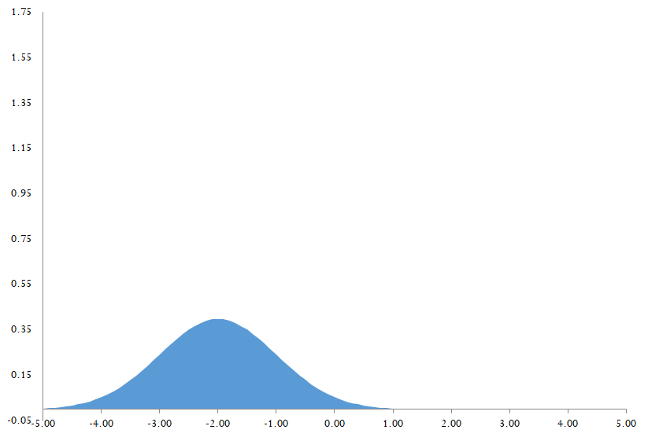
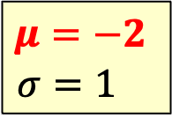
Normal D$istribution N\left(μ,σ^{2}\right):Shape$
N(-2,1)
$$μ=−2$$
$$σ=1$$
-2

Slide 25
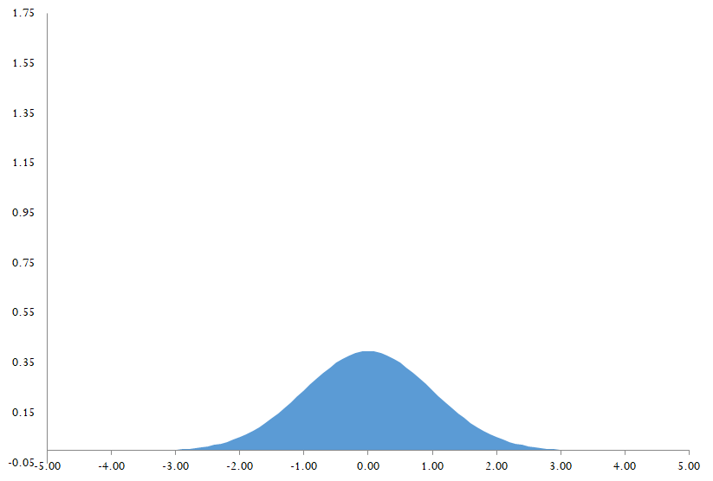
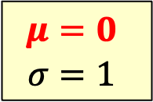
Normal D$istribution N\left(μ,σ^{2}\right):Shape$
N(0,1)
$$μ=0$$
$$σ=1$$
0

Slide 26
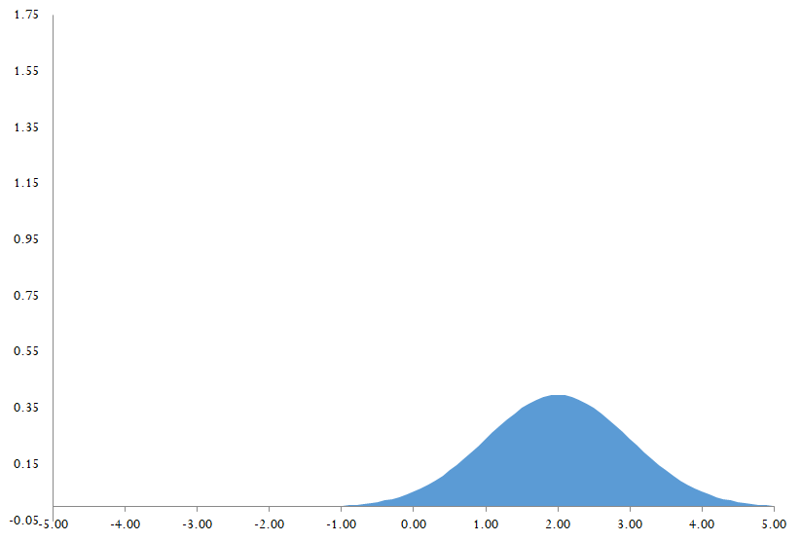
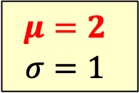
Normal D$istribution N\left(μ,σ^{2}\right):Shape$
N(2,1)
$$μ=2$$
$$σ=1$$
2

Slide 27
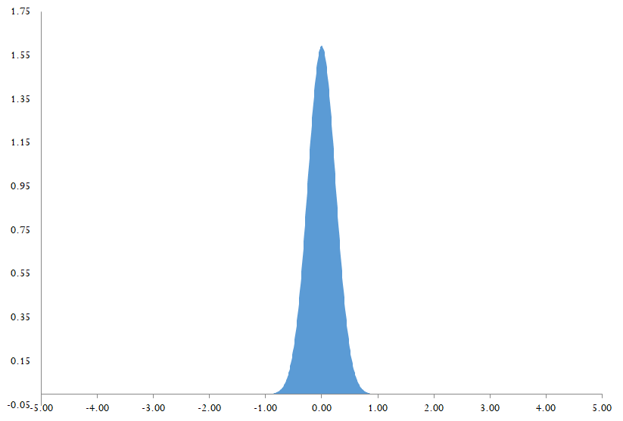
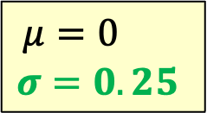
Normal D$istribution N\left(μ,σ^{2}\right):Shape$
N(0,0.0625)
$$μ=0$$
$$σ=0.25$$
0

Slide 28
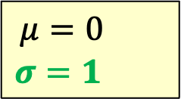
Normal D$istribution N\left(μ,σ^{2}\right):Shape$
N(0,1)
$$μ=0$$
$$σ=1.25$$
0

Slide 29
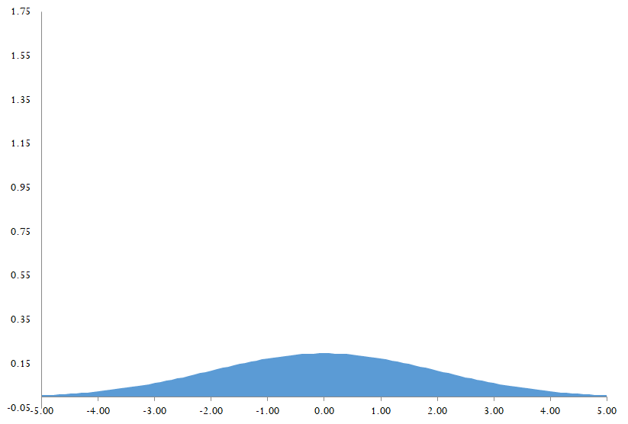
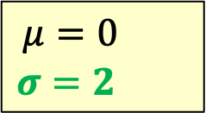
Normal D$istribution N\left(μ,σ^{2}\right):Shape$
N(0,4)
$$μ=0$$
$$σ=2.25$$
0

Slide 30




Probability as Area Under the Curve
Recall:
Area under the curve is 1.0
The curve is symmetric
$$P\left(−∞<X≤μ\right)$$
$$=0.5$$
$$P\left(μ<X<+∞\right)$$
$$=0.5$$
$$P\left(−∞<X<+∞\right)=1$$
Notes:
So half is above the mean, and half is below the mean
Draw on the board: P(X<a), and P(X>b)

Slide 31



Probability as Area Under the Curve
Recall: if $X$ is a continuous random variable, then
$P\left(a<X<b\right)=$ area between $a$ and $b$ under the curve defined by the probability density function.
For any single value $a$: $P\left(X=a\right)=0$
$$P\left(a<X<b\right)$$
=$P\left(a≤X≤b\right)$
= size of this area

Slide 32


1-2-3 Rule for Normal Distribution
A normal distribution is a symmetric curve centered at the mean; there is:
68% chance of being within one std. deviation of the mean
$$P\left(μ−σ<X<μ+σ\right)=0.68$$
Notes:
Translate from X to the standardized normal (the “Z” distribution) by subtracting the mean of X and dividing by its standard deviation:

Slide 33



1-2-3 Rule for Normal Distribution
A normal distribution is a symmetric curve centered at the mean; there is:
95% chance of being within two std. deviation of the mean
$$P\left(μ−2σ<X<μ+2σ\right)=0.95$$
99.7% chance of being within three std. deviation of the mean
$$P\left(μ−3σ<X<μ+3σ\right)=0.997$$
Notes:
Translate from X to the standardized normal (the “Z” distribution) by subtracting the mean of X and dividing by its standard deviation:

Slide 34





Standardization: Convert X to Z
Any normally distributed variable $X\sim N(μ,σ^{2})$ can be related to
a standardized normal variable $Z\sim N(0,1)$with mean = 0 and std = 1
For any normal distribution: only need to care about
the distance from the value of X to the mean $μ$, i.e. ($X−μ$)
using σ as the unit to measure that distance
If $X\sim N(μ,σ^{2})$
then $Z=\frac{X−μ}{σ} \sim N(0,1)$
$$P\left(X<a\right) = P\left(\frac{X−μ}{σ}<\frac{a−μ}{σ}\right)=P(Z<\frac{a−μ}{σ})$$
$$P\left(X>b\right) = P\left(\frac{X−μ}{σ}>\frac{b−μ}{σ}\right)=P(Z>\frac{b−μ}{σ})$$
Notes:
Another 30 minutes to get here: Finish at 55 minutes in total; 11:55am

Slide 35




Relationship Between $N\left(μ,σ^{2}\right)$ and $N\left(0,1\right)$
For any normal variable:
$X\sim N(μ,σ^{2})$
Define new random variable:
$$Z=\frac{X−μ}{σ}$$
Then $Z$ is a standard normal variable:
$$Z\sim N(0,1)$$

Slide 36




What does Z tell us?
X is a normally distributed random variable normally with mean with mean $μ=$ $20 and standard deviation $σ=$ $5
For X = $30,
X = $30 is two standard deviations above the mean ($20)
For X = $15,
X = $15 is one standard deviation below the mean ($20)
$$\text{the} \text{Z} \text{value} \text{is} Z=\frac{X−μ}{σ}=\frac{30−20}{5}=2$$
$$\text{the} \text{Z} \text{value} \text{is} Z=\frac{X−μ}{σ}=\frac{15−20}{5}=−1$$
Notes:
Translate from X to the standardized normal (the “Z” distribution) by subtracting the mean of X and dividing by its standard deviation:

Slide 37

Normal Probabilities in 3 Steps
… if X$is normally distributed.$
If $X\sim N\left(μ,σ^{2}\right)$, we can find $P\left(X>a\right)$, $P\left(X<a\right)$and $P\left(a<X<b\right)$:
Step 1: Convert X-values to Z-values
Step 2: Sketch a bell-shaped curve in terms of Z
Step 3: Use the 1-2-3 rule
Notes:
Translate from X to the standardized normal (the “Z” distribution) by subtracting the mean of X and dividing by its standard deviation:

Slide 38
Example 1: Wait Time on the Phone
… X$is normally distributed.$
Director of customer support studied the time customers spent on hold waiting for a representative to become available.
- Time spent on hold is normally distributed
- Mean = 18 mins
- Standard deviation = 4 mins
Q1. P(a customer waits less than 6 mins)
Q2. P(a customer waits more than 10 mins)
Q3. P(a customer waits more than 22 mins)
Notes:
Do you think that the customer is accurate with her claim?

Slide 39









Example 1: Wait Time on the Phone
… X$is normally distributed.$
Time spent on hold, X is a normal variable with $μ=18$ mins and $σ=4$ mins.
Q1. P(a customer waits less than 6 mins)
$$P\left(X<6\right)$$
$$=P(\frac{X−μ}{σ}<\frac{6−μ}{σ})$$
Standardization (X → Z)
$$=P( Z < \frac{6−μ}{σ})$$
$$=P( Z < \frac{6−18}{4})$$
$$=P(Z<−3)$$
$$=\frac{1−99.7\%}{2}$$
$$=0.0015$$
1-2-3 Rule
Notes:
Translate from X to the standardized normal (the “Z” distribution) by subtracting the mean of X and dividing by its standard deviation:

Slide 40







Example 1: Wait Time on the Phone
… X$is normally distributed.$
Time spent on hold, X is a normal variable with $μ=18$ mins and $σ=4$ mins.
Q2. P(a customer waits more than 10 mins) =
$$P\left(X>10\right)$$
$$=P(\frac{X−μ}{σ}>\frac{10−μ}{σ})$$
$$=P( Z > \frac{10−μ}{σ})$$
$$=P(Z > \frac{10−18}{4})$$
$$=P(Z>−2)$$
Notes:
Translate from X to the standardized normal (the “Z” distribution) by subtracting the mean of X and dividing by its standard deviation:

Slide 41





Example 1: Wait Time on the Phone
… X$is normally distributed.$
Time spent on hold, X is a normal variable with $μ=18$ mins and $σ=4$ mins.
Q2. P(a customer waits more than 10 mins) =
$$P\left(X>10\right)$$
$$=P(\frac{X−μ}{σ}>\frac{10−μ}{σ})$$
$$=P( Z > \frac{10−μ}{σ})$$
$$=P(Z > \frac{10−18}{4})$$
$$=P(Z>−2)$$
$$=1−\frac{1−95\%}{2}$$
$$=1−P(Z<−2)$$
$$=0.9750$$
Notes:
Translate from X to the standardized normal (the “Z” distribution) by subtracting the mean of X and dividing by its standard deviation:

Slide 42









Example 1: Wait Time on the Phone
… X$is normally distributed.$
Time spent on hold, X is a normal variable with $μ=18$ mins and $σ=4$ mins.
Q3. P(a customer waits more than 22 mins) =
$$=P(\frac{X−μ}{σ}>\frac{22−μ}{σ})$$
$$P\left(X>22\right)$$
Standardization (X → Z)
$$=P( Z >\frac{22−μ}{σ})$$
$$=P(Z > \frac{22−18}{4})$$
$$=P(Z>1)$$
$$=\frac{1−68\%}{2}$$
$$=0.16$$
1-2-3 Rule
Notes:
Translate from X to the standardized normal (the “Z” distribution) by subtracting the mean of X and dividing by its standard deviation:
Thus, while it is undesirable for a customer to have to wait, this waiting time is not considered
extremely unusual. (d) If they want no chance of someone waiting longer than 18 minutes,
the standard deviation for wait time would have to be zero. This is impractical.

Slide 43






Example 2: Image Download Times
… X$is normally distributed.$
Download time X is a normal variable with $μ=18$ seconds and $σ=5$ seconds.
Q1. P(Downloading time is between 18 and 23) =
Step 1:
$$P\left(18<X<23\right)$$
$$=P(\frac{18−μ}{σ}<\frac{X−μ}{σ}<\frac{23−μ}{σ})$$
$$=P(\frac{18−μ}{σ}< Z < \frac{23−μ}{σ})$$
$$=P(\frac{18−18}{5}< Z < \frac{23−18}{5})$$
$$=P(0<Z<1)$$
Notes:
Translate from X to the standardized normal (the “Z” distribution) by subtracting the mean of X and dividing by its standard deviation:

Slide 44






Example 2: Image Download Times
… X$is normally distributed.$
Download time X is a normal variable with $μ=18$ seconds and $σ=5$ seconds.
Q1. P(Downloading time is between 18 and 23) =
Step 2:
Step 3:
$$P\left(18<X<23\right)$$
$$=P\left(0<Z<1\right)$$
$$=\frac{68\%}{2}$$
$$=34\%$$
Notes:
Translate from X to the standardized normal (the “Z” distribution) by subtracting the mean of X and dividing by its standard deviation:

Slide 45



Example 2: Image Download Times
… X$is normally distributed.$
Download time X is a normal variable with $μ=18$ seconds and $σ=5$ seconds.
Q2. Find X such that 16% of download times are less than X.
Step 1: Find the Z value for the known probability.
Notes:
Translate from X to the standardized normal (the “Z” distribution) by subtracting the mean of X and dividing by its standard deviation:

Slide 46





Example 2: Image Download Times
… X$is normally distributed.$
Download time X is a normal variable with $μ=18$ seconds and $σ=5$ seconds.
Q2. Find X such that 16% of download times are less than X.
Step 2: Convert $Z=−1$ to X-value.
16% of the values are less than 13 seconds
$Z=\frac{X−μ}{σ}=−1$
$$X=μ+\text{(−1)}∙\text{σ}$$
$$=18+\text{(−1)}∙\text{5}$$
$$=13$$
Notes:
Translate from X to the standardized normal (the “Z” distribution) by subtracting the mean of X and dividing by its standard deviation:

Slide 47







Distribution of the Sample Mean ($\overline{X}$)
… r$eview …what if we don^{′}t know the distribution?$
Observations $X_{1},X_{2},…,X_{n}$
$\overline{X}$ is a random variable:
For any population distribution:
Central Limit Theorem: when n is large
$$\overline{X}=\frac{X_{1}+X_{2}+…+X_{n}}{n}$$
$$μ_{\overline{X}}=μ$$
$$σ_{\overline{X}}=\frac{σ}{\sqrt{n} }<σ$$
$\overline{X}\sim N\left(μ_{\overline{X}}, σ_{\overline{X}}^{2}\right)$ $=N\left(μ, \frac{σ^{2}}{n}\right)$
Notes:
Translate from X to the standardized normal (the “Z” distribution) by subtracting the mean of X and dividing by its standard deviation:

Slide 48





Z-Value for the Sample Mean ($\overline{X}$)
Z-value for the distribution of $\overline{X}$
Features of $\overline{X}$:
$$μ_{\overline{X}}=μ$$
$$σ_{\overline{X}}=\frac{σ}{\sqrt{n} }$$
$$\overline{X}\sim N\left(μ_{\overline{X}},σ_{\overline{X}}^{2}\right)$$
$$Z=\frac{\overline{X}−μ_{\overline{X}}}{σ_{\overline{X}}}=\frac{\overline{X}−μ }{\frac{σ}{\sqrt{n} }}$$
where $\overline{X}$ = sample mean
$μ$= population mean
$σ$ = population standard deviation
n = sample size
Notes:
A measure of the variability in the mean from sample to sample is given by

Slide 49

Example 3
… X$is NOT normally distributed.$
Suppose a population has mean $μ=8$ and standard deviation $σ=3.$A random sample of size $n=36$ is selected.
Q. What is the probability that the sample mean is between 6.5 and 9?
Mean: $μ_{\overline{X}}=μ=8$
Standard deviation: $σ_{\overline{X}}=\frac{σ}{\sqrt{n} }=$ $\frac{3}{\sqrt{36} }=\frac{3}{6 }=0.5$
Notes:
A measure of the variability in the mean from sample to sample is given by

Slide 50






Example 3
$$μ_{\overline{X}}=μ=8$$
$$σ_{\overline{X}}=\frac{σ}{\sqrt{n} }=0.5$$
$\overline{X}\sim N\left(μ_{\overline{X}},σ_{\overline{X}}^{2}\right)$ $=N\left(8, {0.5}^{2}\right)$
… X$is NOT normally distributed.$
$$P\left(6.5<\overline{X}<9\right)$$
$$=P\left(\frac{6.5−μ_{\overline{X}}}{σ_{\overline{X}}}<\frac{\overline{X}−μ_{\overline{X}}}{σ_{\overline{X}}}<\frac{9−μ_{\overline{X}}}{σ_{\overline{X}}}\right)$$
$$=P\left(\frac{6.5−8}{0.5} < Z < \frac{9−8}{0.5}\right)$$
$$=P\left(−3<Z<2\right)$$
Notes:
A measure of the variability in the mean from sample to sample is given by

Slide 51



Example 3
$$μ_{\overline{X}}=μ=8$$
$$σ_{\overline{X}}=\frac{σ}{\sqrt{n} }=0.5$$
$\overline{X}\sim N\left(μ_{\overline{X}},σ_{\overline{X}}^{2}\right)$ $=N\left(8, {0.5}^{2}\right)$
… X$is NOT normally distributed.$
$$P\left(6.5<\overline{X}<9\right)$$
$$=P\left(\frac{6.5−μ_{\overline{X}}}{σ_{\overline{X}}}<\frac{\overline{X}−μ_{\overline{X}}}{σ_{\overline{X}}}<\frac{9−μ_{\overline{X}}}{σ_{\overline{X}}}\right)$$
$$=P\left(\frac{6.5−8}{0.5} < Z < \frac{9−8}{0.5}\right)$$
$$=P\left(−3<Z<2\right)$$
$$=P\left(−3<Z<0\right)+P\left(0<Z<2\right)$$
$$=\frac{99.7\%}{2}+\frac{95\%}{2}$$
$$=0.974$$
Notes:
A measure of the variability in the mean from sample to sample is given by

Slide 52

Example 4
… X$is NOT normally distributed.$
Suppose a population has mean $μ=368$ and standard deviation $σ=15.$A random sample of size $n=25$ is selected.
Q. What is a symmetrically distributed interval around $μ$ that includes 95% of all sample means?
Notes:
A measure of the variability in the mean from sample to sample is given by

Slide 53


Example 4
… X$is NOT normally distributed.$
Suppose a population has mean $μ=368$ and standard deviation $σ=15.$A random sample of size $n=25$ is selected.
Q. What is a symmetrically distributed interval around $μ$ that includes 95% of all sample means?
Step 1: Find the Z value for the known probability.
95%
Notes:
A measure of the variability in the mean from sample to sample is given by

Slide 54








Example 4
… X$is NOT normally distributed.$
Q. What is a symmetrically distributed interval around $μ$ that includes 95% of all sample means?
Step 2: Convert $Z=2$ and $−2$ to $\overline{X}$
95%
Upper bound of $\overline{X}=μ_{\overline{X}}+Z∙σ_{\overline{X}}$
$$=μ +\text{Z}∙\frac{σ}{\sqrt{n} }$$
374
$$μ=368$$
$$σ=15$$
$$n=25$$
$$=μ +\text{2}∙\frac{σ}{\sqrt{n} }$$
$$=368 +\text{2}∙\frac{15}{\sqrt{25} }$$
$$=374$$
Notes:
Since the interval contains 95% of the sample means 5% of the sample means will be outside the interval
Since the interval is symmetric 2.5% will be above the upper limit and 2.5% will be below the lower limit.
From the standardized normal table, the Z score with 2.5% (0.0250) below it is -1.96 and the Z score with 2.5% (0.0250) above it is 1.96.

Slide 55






Example 4
… X$is NOT normally distributed.$
Q. What is a symmetrically distributed interval around $μ$ that includes 95% of all sample means?
Step 2: Convert $Z=2$ and $−2$ to $\overline{X}$
95%
Lower bound of $\overline{X}=μ_{\overline{X}}+Z∙σ_{\overline{X}}$
$$=μ +\text{Z}∙\frac{σ}{\sqrt{n} }$$
362
374
$$μ=368$$
$$σ=15$$
$$n=25$$
$$=μ +(−\text{2)}∙\frac{σ}{\sqrt{n} }$$
$$=368 +(−\text{2})∙\frac{15}{\sqrt{25} }$$
$$=362$$
Notes:
Since the interval contains 95% of the sample means 5% of the sample means will be outside the interval
Since the interval is symmetric 2.5% will be above the upper limit and 2.5% will be below the lower limit.
From the standardized normal table, the Z score with 2.5% (0.0250) below it is -1.96 and the Z score with 2.5% (0.0250) above it is 1.96.

Slide 56


Example 4
… X$is NOT normally distributed.$
Q. What is a symmetrically distributed interval around $μ$ that includes 95% of all sample means?
Answer: When taking all different samples with size = 25,
95% of all those sample means are between 362 and 374.
Notes:
Since the interval contains 95% of the sample means 5% of the sample means will be outside the interval
Since the interval is symmetric 2.5% will be above the upper limit and 2.5% will be below the lower limit.
From the standardized normal table, the Z score with 2.5% (0.0250) below it is -1.96 and the Z score with 2.5% (0.0250) above it is 1.96.

Slide 57

Central Limit Theorem in Practice
… in practice we do not know the population statistics like $μ$and $σ$.
The CLT says:
$$\overline{X}\sim N\left(μ, {\left(\frac{σ}{\sqrt{n}}\right)}^{2}\right)$$
Q. How do we use the CLT when we don’t know $μ$or $σ?$
Use the sample estimate!
Notes:
But how do we do that?

Slide 58

Population Statistic Sample Estimate
Population Parameter | Guess Based on a Sample
Population Mean $μ$ | Sample Mean $\overline{X}$
Population Variance ${ σ}^{2}$ | Sample Variance${ S}^{2}$
Population Std. Dev. $σ$ | Sample Std. Dev. $S$
Notes:
Let’s see some example!

Slide 59
Example 5: Vending Machine
… X$is NOT normally distributed and we do not know the distribution.$
For a period of 144 days, daily observations have been conducted about the number of candy bars sold from a vending machine. Using these observations:
Mean of the sample = 258
Standard deviation of the sample = 60
Q. For a 144-day period, find:
P(average number of candy bars sold > 263) =
Notes:
Is calculated to be equal to

Slide 60


Example 5: Vending Machine
… X$is NOT normally distributed and we do not know the distribution.$
For a period of 144 days, daily observations have been conducted about the number of candy bars sold from a vending machine. Using these observations:
Mean of the sample = 258
Standard deviation of the sample = 60
Q. For a 144-day period, find:
P(average number of candy bars sold > 263) =
$$\overline{X}=258,$$
Good guess of
population mean $μ$
$$S=60,$$
Good guess of
population std. dev. $σ$
Notes:
Is calculated to be equal to

Slide 61










Example 5: Vending Machine
… X$is NOT normally distributed and we do not know the distribution.$
$$n=144, μ=258, σ=60$$
P(average number of candy bars sold > 263) =
mean $μ_{\overline{X}}=μ=258$
For $\overline{X}:$
standard deviation $σ_{\overline{X}}=\frac{σ}{\sqrt{n} }=$ $\frac{60}{\sqrt{144} }=\frac{60}{12}=5$
$$\overline{X}\sim N\left(μ_{\overline{X}},{σ_{\overline{X}}}^{2}\right)=N\left(258,{\left(5\right)}^{2}\right)$$
$=P\left( \frac{\overline{X}−μ_{\overline{X}}}{σ_{\overline{X}}}>\frac{263−μ_{\overline{X}}}{σ_{\overline{X}}}\right)$
P($\overline{X}>263)$
$=P\left( Z > \frac{263−258}{5}\right)$
$$=P\left( Z>1\right)$$
$$=0.16$$
Notes:
Is calculated to be equal to

Slide 62



Proportions: a special case
We collect a random sample of size n. Each person in the sample may or may not have the characteristics of interest.
1 if person i has the characteristic (answer “Yes”)
$$X_{i}=$$
0 if not (answer “No”)
Each $X_{i}$ is a binary random variable
Prob ($X_{i}=1)=p$
Prob ($X_{i}=0)=1−p$
Notes:
A measure of the variability in the mean from sample to sample is given by

Slide 63






Distribution of Sample Proprotion ($\hat{p})$
$$σ_{\hat{p}}=\sqrt{\frac{p(1−p)}{n}}$$
$$σ_{\hat{p}}$$
$$When sample is$$
$$large enough$$
$\hat{p}\sim N\left(μ_{\hat{p}}, { σ}_{\hat{p}}^{2} \right)=N(p,\frac{p(1−p)}{n}$)
Notes:
Translate from X to the standardized normal (the “Z” distribution) by subtracting the mean of X and dividing by its standard deviation:

Slide 64

Majors of Pitt Graduates With a Bachelor’s Degree
Pop. Proportion (2019):
Among all Pitt undergrads,
%(majored in psychology) = 7.1%

Slide 65






Example 6: Psychology Students
… X$is NOT normally distributed.$
Q. From 240 randomly selected students, what is the probability that the number of students who will obtain a psychology degree is between 17 and 28?
Let $\hat{p}$= sample proportion of a sample with size 240
$$=8$$
Population
$μ_{\hat{p}}=p=0.07$1
$$σ_{\hat{p}}=\sqrt{\frac{p(1−p)}{n}}=0.015$$
$p=0.07$1
Sample size
$$np>5$$
$$n(1−p)>5$$
$$n=240$$
$$\hat{p}\sim N\left(0.071, {0.015}^{2}\right)$$
Notes:
A measure of the variability in the mean from sample to sample is given by

Slide 66



$μ_{\hat{p}}=0.07$1
$$σ_{\hat{p}}=0.015$$
$$\hat{p}\sim N\left(0.071, {0.015}^{2}\right)$$
Example 6: Psychology Students
… X$is NOT normally distributed.$
P(# of students who will obtain a psychology degree is between 17 and 28) =
$$P\left(17<\hat{p}<28\right)$$
$$P\left(\frac{17}{240}<\hat{p}<\frac{28}{240}\right)$$
proportion
out of a sample of 240
Notes:
A measure of the variability in the mean from sample to sample is given by

Slide 67





$μ_{\hat{p}}=0.07$1
$$σ_{\hat{p}}=0.015$$
$$\hat{p}\sim N\left(0.071, {0.015}^{2}\right)$$
Example 6: Psychology Students
… X$is NOT normally distributed.$
P(# of students who will obtain a psychology degree is between 17 and 28) =
$$=8$$
$$P\left(\frac{17}{240}<\hat{p}<\frac{28}{240}\right)$$
$$=P\left(0.071<\hat{p}<0.117\right)$$
$$=P\left(\frac{0.071−μ_{\hat{p}}}{σ_{\hat{p}}} < \frac{\hat{p}−μ_{\hat{p}}}{σ_{\hat{p}}} < \frac{0.117−μ_{\hat{p}}}{σ_{\hat{p}}}\right)$$
$$=P\left(\frac{0.071−0.071 }{0.015}< Z < \frac{0.117−0.071}{0.015}\right)$$
$$=P\left(0<Z<3.07\right)$$
Notes:
A measure of the variability in the mean from sample to sample is given by

Slide 68







$μ_{\hat{p}}=0.07$1
$$σ_{\hat{p}}=0.015$$
$$\hat{p}\sim N\left(0.071, {0.015}^{2}\right)$$
Example 6: Psychology Students
… X$is NOT normally distributed.$
P(# of students who will obtain a psychology degree is between 17 and 28)
Accurate answer
Hands-on answer:
$$P\left(\frac{17}{240}<\hat{p}<\frac{28}{240}\right)$$
$$=P\left(0<Z<3.07\right)$$
$$= P\left(Z<3.07\right)−P\left(Z<0\right)$$
$$=norm.s.dist(3.07, true)−0.5$$
$$=0.9989−0.5=0.4989$$
$$=\frac{99.7\%}{2}$$
$$≈P\left(0<Z<3\right)$$
$$=0.4985$$
Notes:
A measure of the variability in the mean from sample to sample is given by

